Slide 1
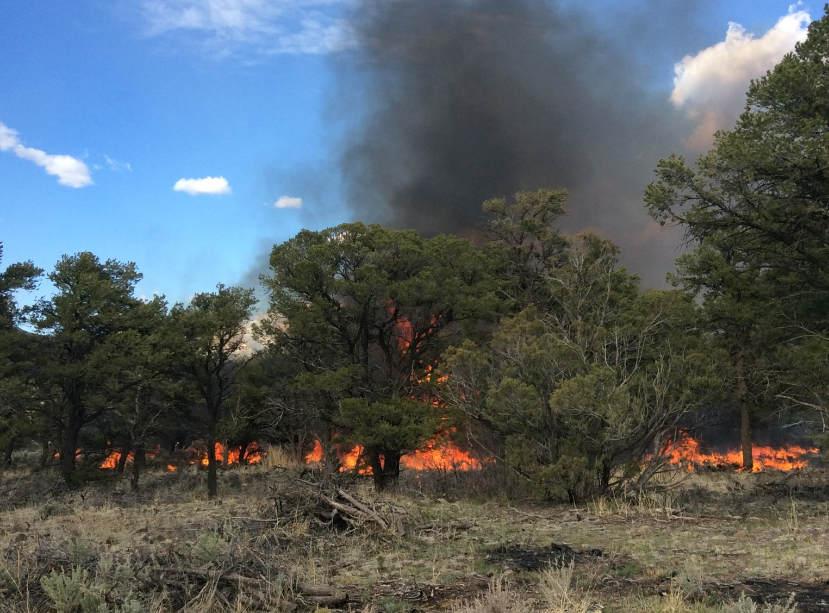
Mimicking Wildfire Regimes to Improve Sagebrush Habitat in Eastern Nevada
Kyndal Olin, Nelson Stauffer & Alex Traynor
Notes:
Jackpot burn

Slide 2
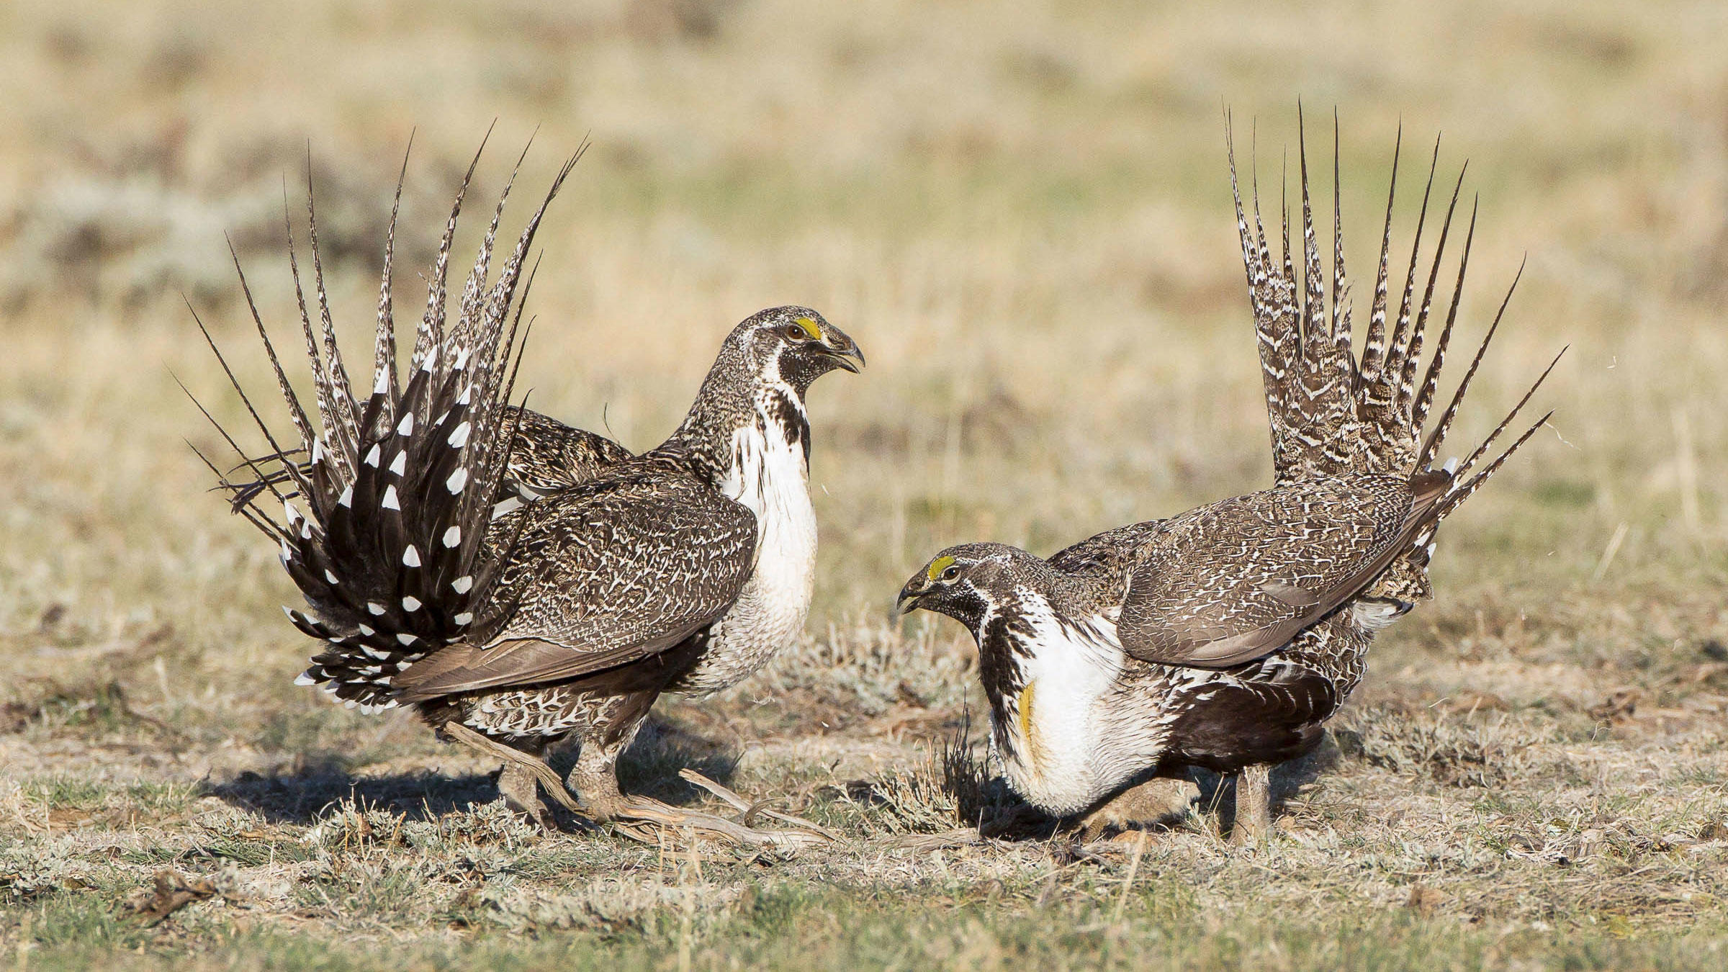
Fall
(Sep - Dec)
Winter
(Dec - Mar)
Sage Grouse
Habitat and Ecology
Late Brood Rearing
(Jul - Sep)
Lekking Season
(Mar - May)
Early Brood Rearing (Apr - Jul)
Notes:
lekkng - wide open spaces to dance
early brood - 15-25% ARTR2 to protect eggs + diversity of grasses and forbs
late brood - 10 - 15 % ARTR2 + riparian areas
fall/winter - ARTR2 for food, height of ARTR2 above snow is impt

Slide 3
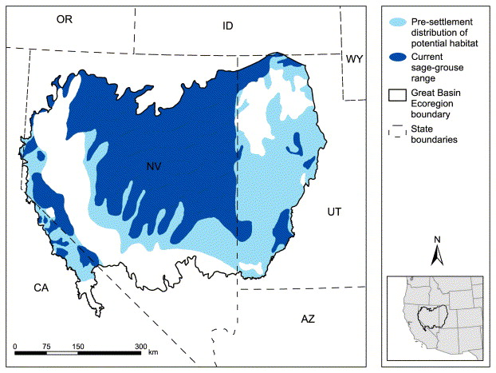
Pinyon - Juniper Encroachment
Source : Schroeder 2002.
Notes:
pj expansion since european settlement - reducing GRSG habitat
decreased fire frequency
historical grazing regimes
atmospheric conditions (e.g. CO2)
negative effects of catastrophic wildfire - annual grassland conversion
Point out where on map Patterson is

Slide 4
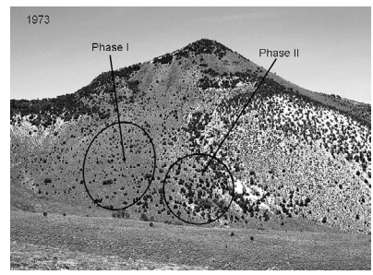
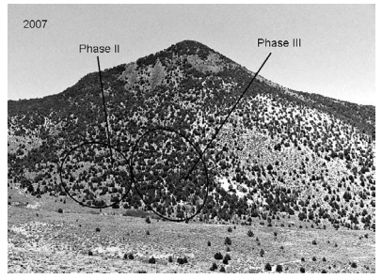
Pinyon - Juniper Expansion
Source : Miller et al. 2008
Notes:
pj expansion since european settlement - reducing GRSG habitat + avian predation
decreased fire frequency
historical grazing regimes
atmospheric conditions (e.g. CO2)
negative effects of catastrophic wildfire - annual grassland conversion
pic from shoshone mts NV

Slide 5
Research Questions
Can Sage Grouse habitat be improved with Pinyon-Juniper removal treatments?
Which treatment method works best for improving habitat?
Are there any unintended ecological effects from mechanical removal treatments?
Are Assessment, Inventory and Monitoring (AIM) data a useful tool for analyzing Sage Grouse habitat?

Slide 6
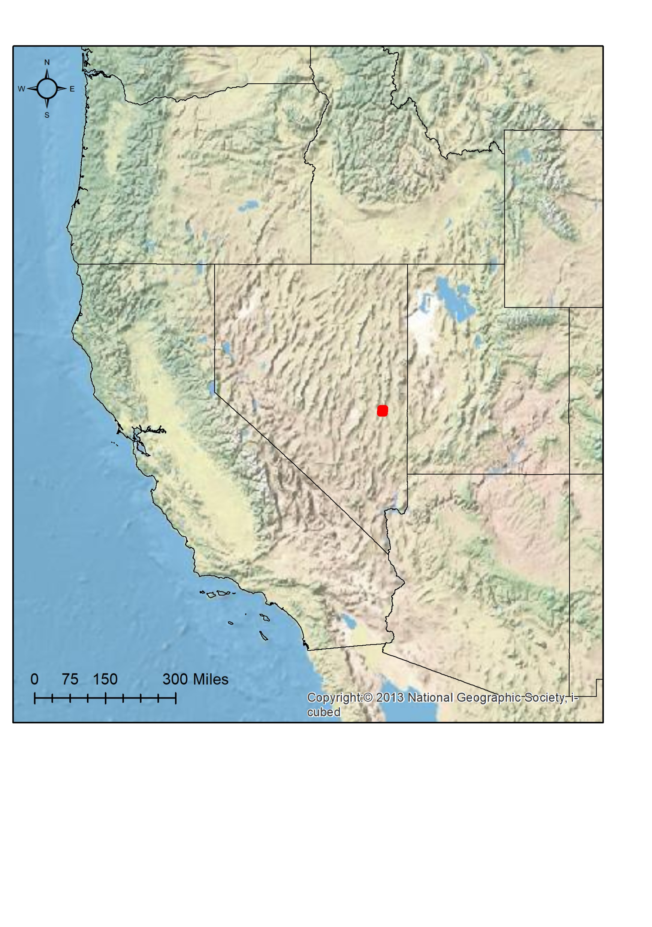
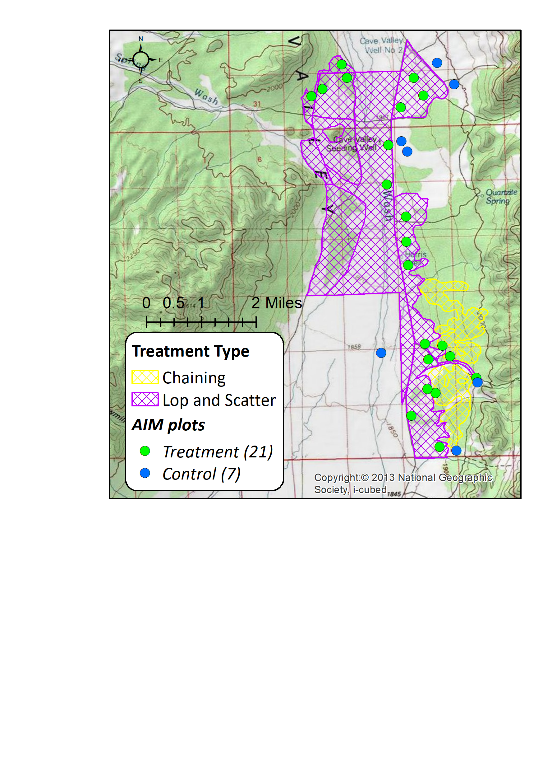
Study Area & Data
Eastern Nevada
Central Basin & Range ecoregion
~7000 acres treated
Chaining
Lop & Scatter
29 AIM plots
21 treatment plots
7 control plots
Visited before and after treatment
Notes:
Also checked wildfire history and no fires occured between resample dates

Slide 7
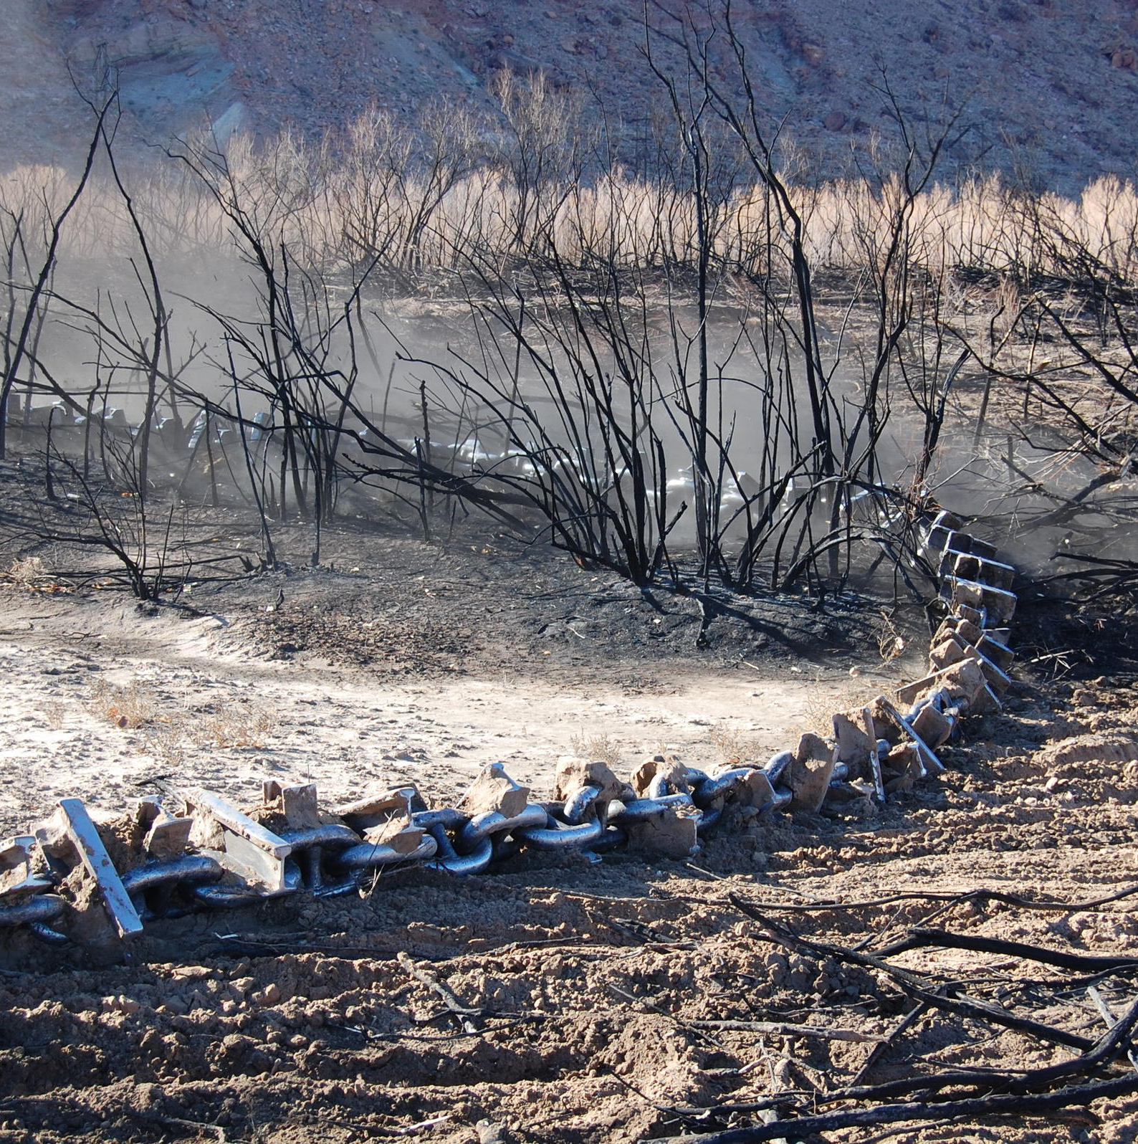
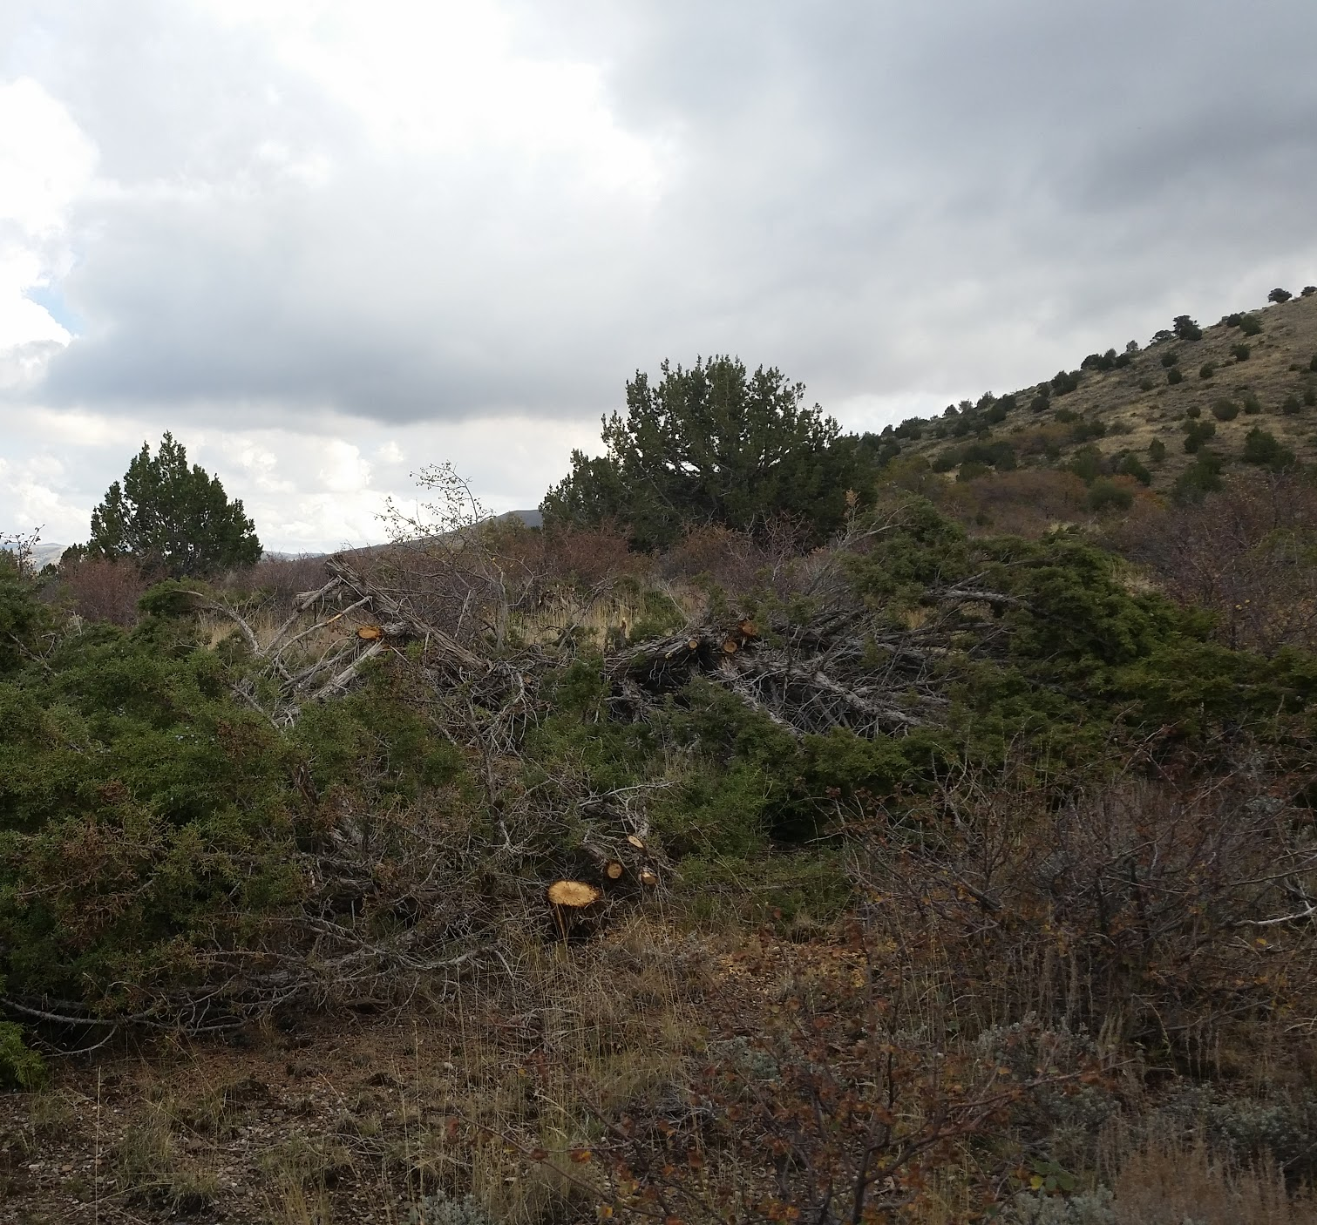
Treatments
Notes:
Chaining treatments were completed in January 2015 and lop and scatter treatments were completed in three parts—in September 2013, August 2014, and August 2015—meaning that the plots had recovery periods of two to four years.

Slide 8
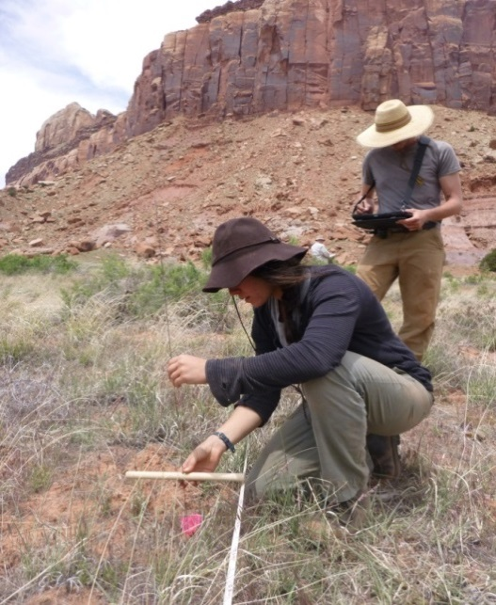
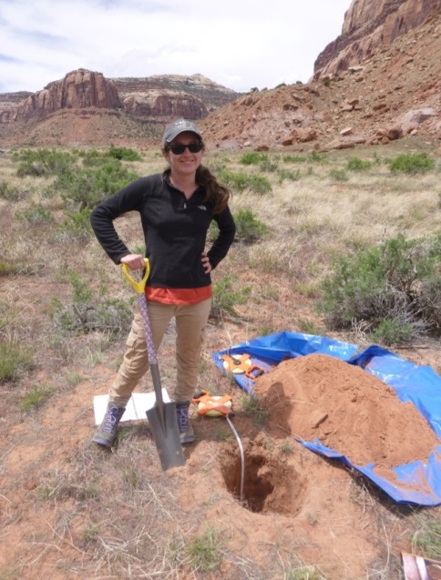
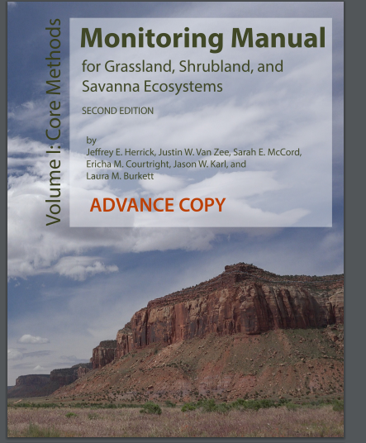
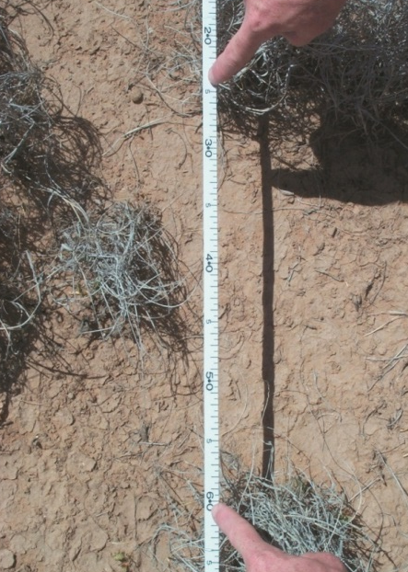

AIM is…
…standard, quantitative indicators and measurements
Bare Ground, Foliar Cover, Litter, Veg Composition & Veg Heights
Soil Characteristics
Canopy Gaps
Soil Stability
Notes:
TALK ABOUT RELEVANCE TO WILDLIFE
A ton of data that can be used for many different applications
Compare to other forest inventory which focuses on trees – this provides much more info
MONITRING MANUAL

Slide 9
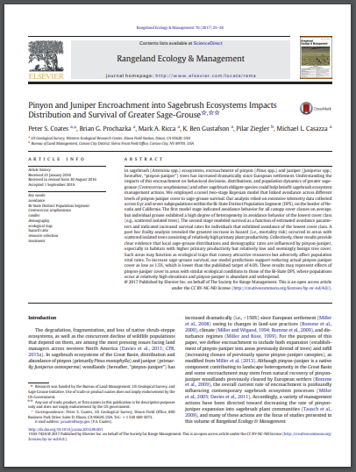


Methods
Literature search for GRSG habitat benchmarks
Peer reviewed journal articles
BLM management plans
Sage Grouse Habitat Assessment Framework
Notes:
For the BLM, the Habitat Assessment Framework is the default but states modify the values to represent the specific conditions they have (Wyoming habitat will never look like Nevada habitat)

Slide 10
Benchmarks
Indicator | Precipitation Regime | Season of Sage-Grouse Use | Acceptable Range
Non-invasive Tree Cover | Arid | Any | 0% <= X <= 1.5%
Invasive Annual Grass Cover | Arid | Any | 0% <= X <= 5%
Sagebrush Cover | Any | Spring | 20% <= X <= 100%
Non-invasive Perennial Grass Cover | Any | Spring | 10% <= X <= 100%
Non-invasive Shrub Cover | Any | Spring | 30% <= X <= 100%
Non-invasive Perennial Forb/Grass Cover | Any | Summer | 15% < X <= 100%
Non-invasive Perennial Forb Cover | Arid | Summer | 5% <= X <= 100%
Non-invasive Perennial Forb Cover | Mesic | Summer | 15% <= X <= 100%
Sagebrush Cover | Arid | Summer | 10% <= X <= 25%
Notes:
These are cover-based benchmarks for Nevada BLM, derived from the Habitat Assessment Framework

Slide 11
Data Analysis
Classified plots into season (spring, summer)
Looked at climate data from PRISM to classify precipitation regime
Compared pre-treatment to post treatment data
Compared treatments to controls
Calculated if benchmarks were met or not for each plot
Notes:
LOOKED AT PRISM DATA

Slide 12
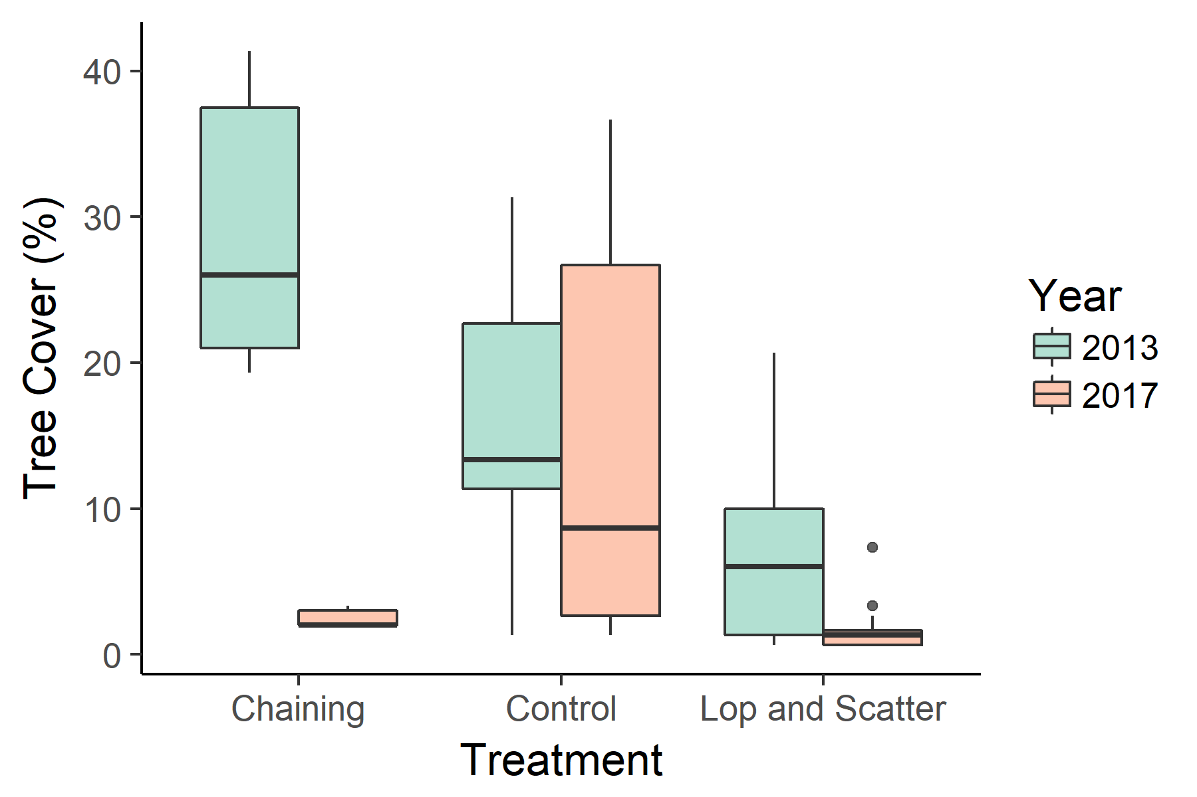
Results
Notes:
Anova + Separate t tests
Chaining and lop and scatter are significantly different before and after treatments
No difference in control between years
Both chaining and Lop and scatter have significantly fewer trees than control in 2017
@ alpha = 0.01

Slide 13
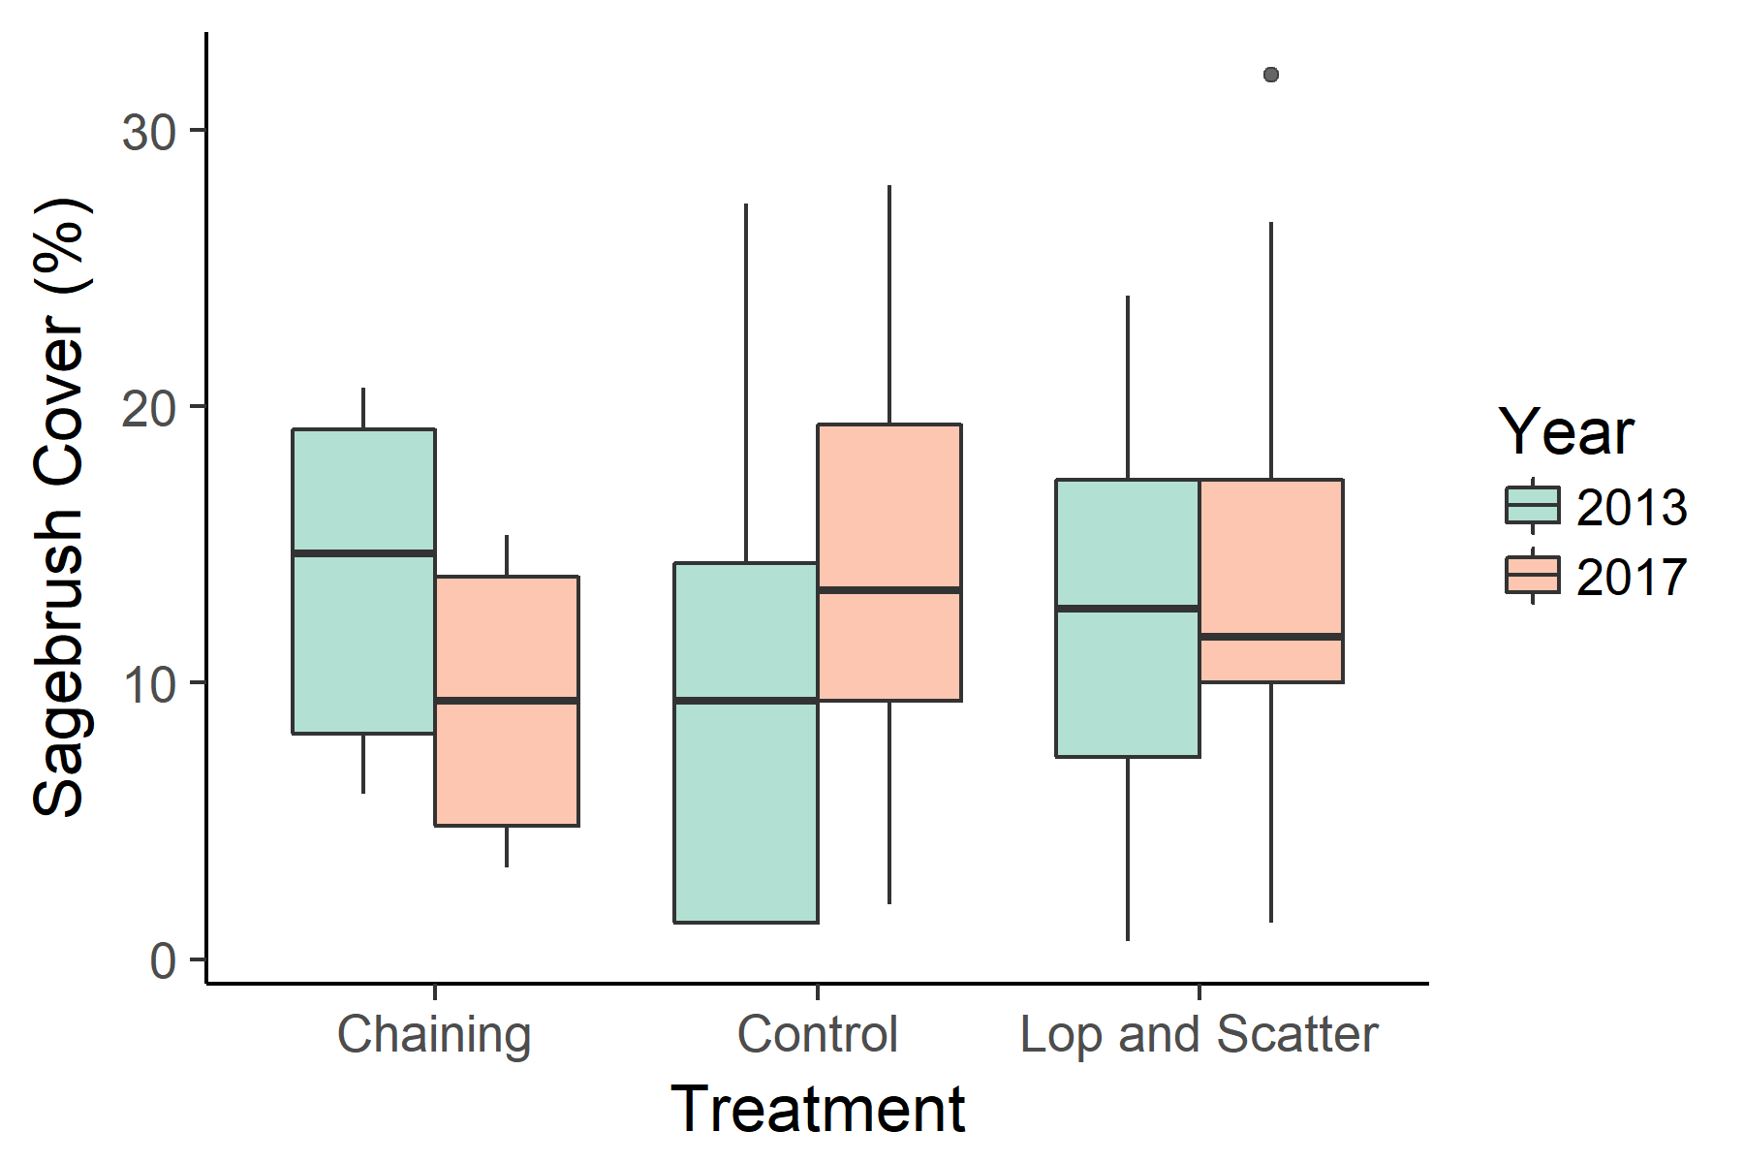
Notes:
No significant differences, although chaining between years is close (p = 0.2305)

Slide 14
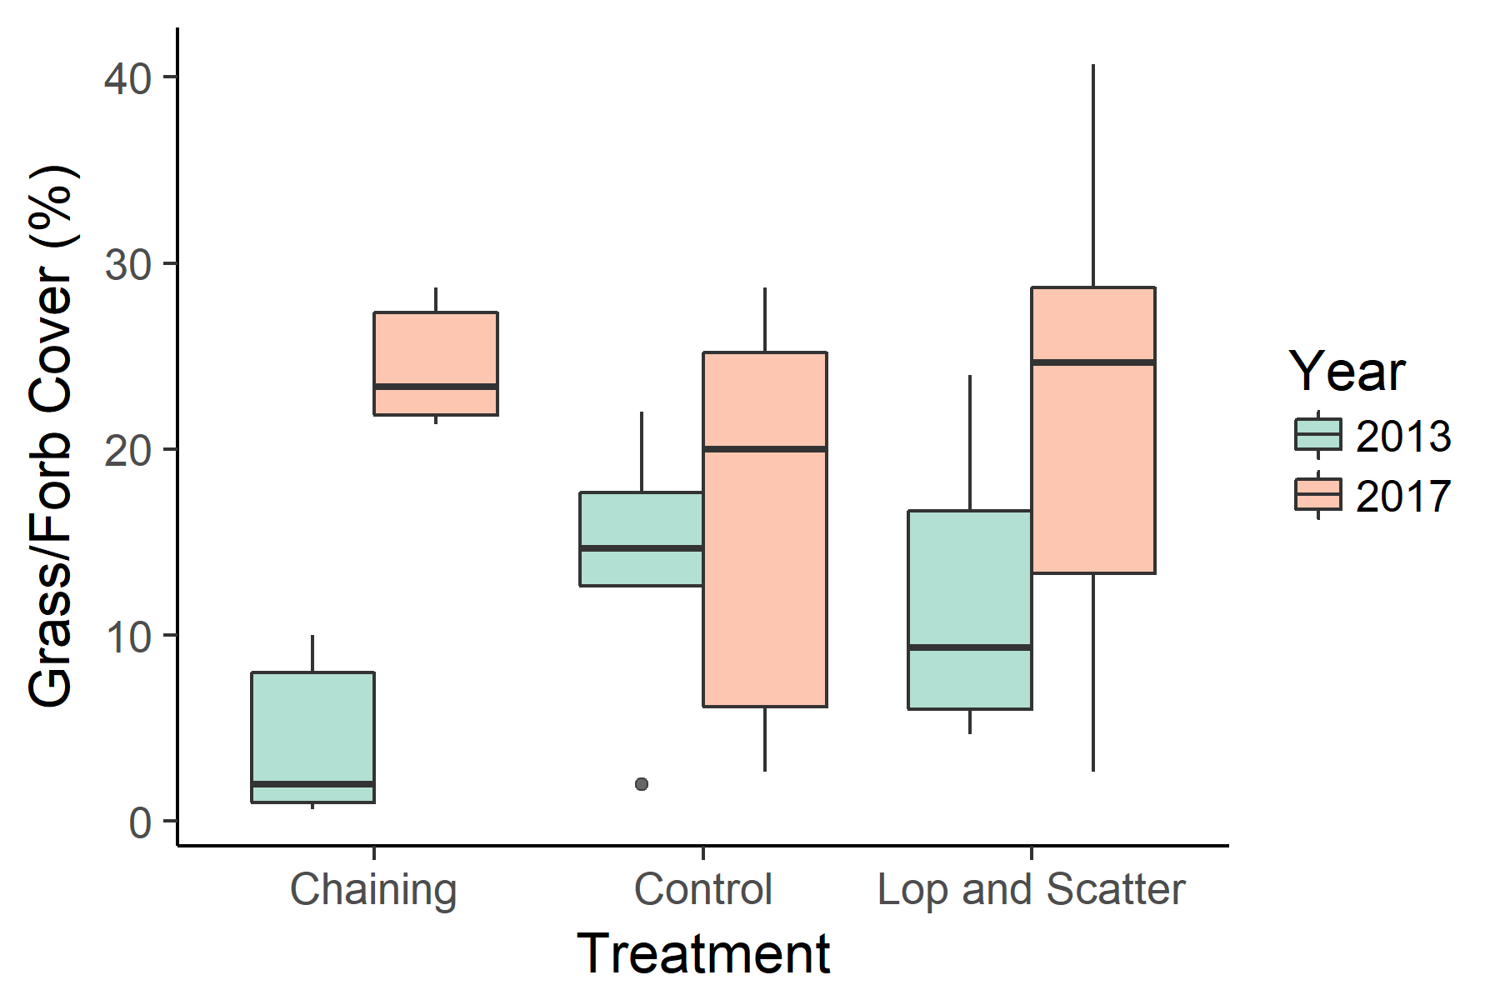
Notes:
Lop and scatter – higher in 2017 (p < 0.001) AND higher than controls in 2017 (p = 0.08)
Chaining - higher in 2017 (p < 0.001) AND higher than controls in 2017 (p = 0.01)
Controls are same between years (p > 0.5)

Slide 15
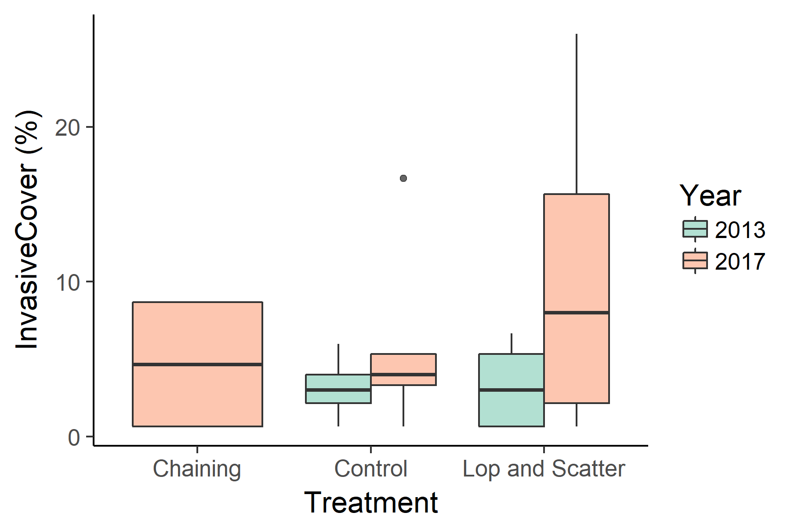
Notes:
No significant differences

Slide 16
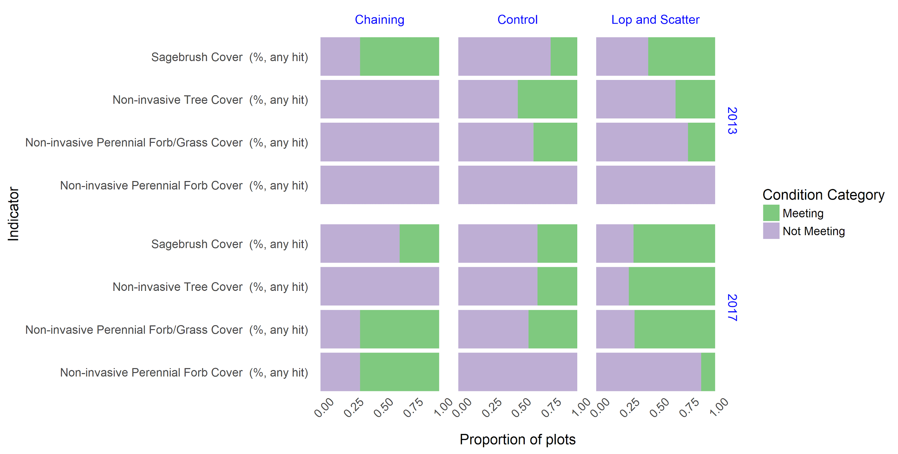
Notes:
Note that chaining is indiscriminate and so sagebrush cover suffered, but this is a limited timescale

Slide 17
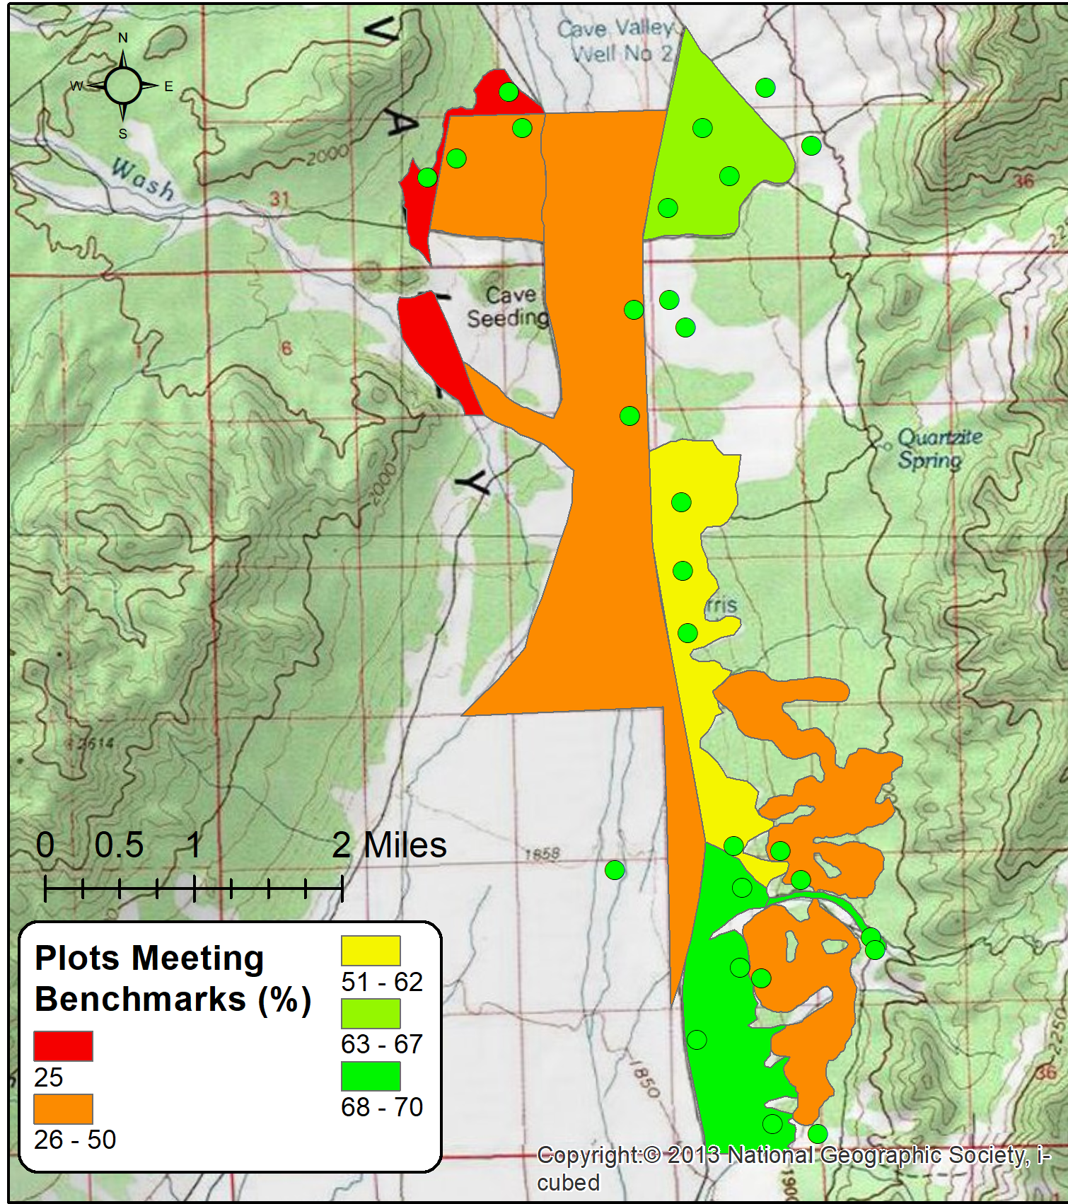
Spatial pattern of benchmark success
Proportion of plots which had ‘acceptable’ rates of benchmark success
Treatments in the northwest were the least successful
Notes:
On the ground I saw that the NW was really washed out and unstable--may be a contributing factor to lack of success--just a Kyndal theory though

Slide 18
Conclusions and Management Implications
Both treatment approaches appeared to increase the number of indicators meeting management goals
There may be differential effects in the undesirable side effects in the treatment methods
Although both treatments were successful, examining the process of deciding which treatment approach to use at a given location may lead to better management decisions
Notes:
Challenges:
Only had plot data from spring and summer stages
Future :
continued monitoring to assess long term impacts of treatments/PJ regen
also could look at effect of recovery times on benchmark success

Slide 19
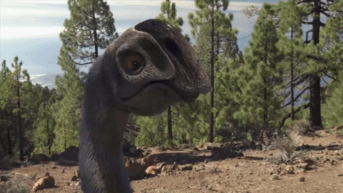
Any Questions?

Slide 20
References
Coates, P.S., Prochazka, B.G., Ricca, M.A., Ben Gustafson, K., Ziegler, P., Casazza, M.L., 2017. Pinyon and Juniper Encroachment into Sagebrush Ecosystems Impacts Distribution and Survival of Greater Sage-Grouse. Rangel. Ecol. Manag. 70, 25–38.
Herrick, J.E., Jornada Experimental Range (Eds.), 2005. Monitoring Manual for Grassland, Shrubland, and Savanna Ecosystems. USDA - ARS Jornada Experimental Range ; Distributed by the University of Arizona Press, Las Cruces, N.M. : Tucson, Ariz.
Miller, Richard F.; Tausch, Robin J.; McArthur, E. Durant; Johnson, Dustin D.; Sanderson, Stewart C. 2008. Age structure and expansion of piñon-juniper woodlands: a regional perspective in the Intermountain West. Res. Pap. RMRS-RP-69. Fort Collins, CO: U.S. Department of Agriculture, Forest Service, Rocky Mountain Research Station. 15 p
Schroeder, M.A., 2002. Current and historic distribution of greater and Gunnison sage-grouse in North America. Map Edition 1.1. Washington Department of Fish and Wildlife, Olympia, WA

